Slide 1
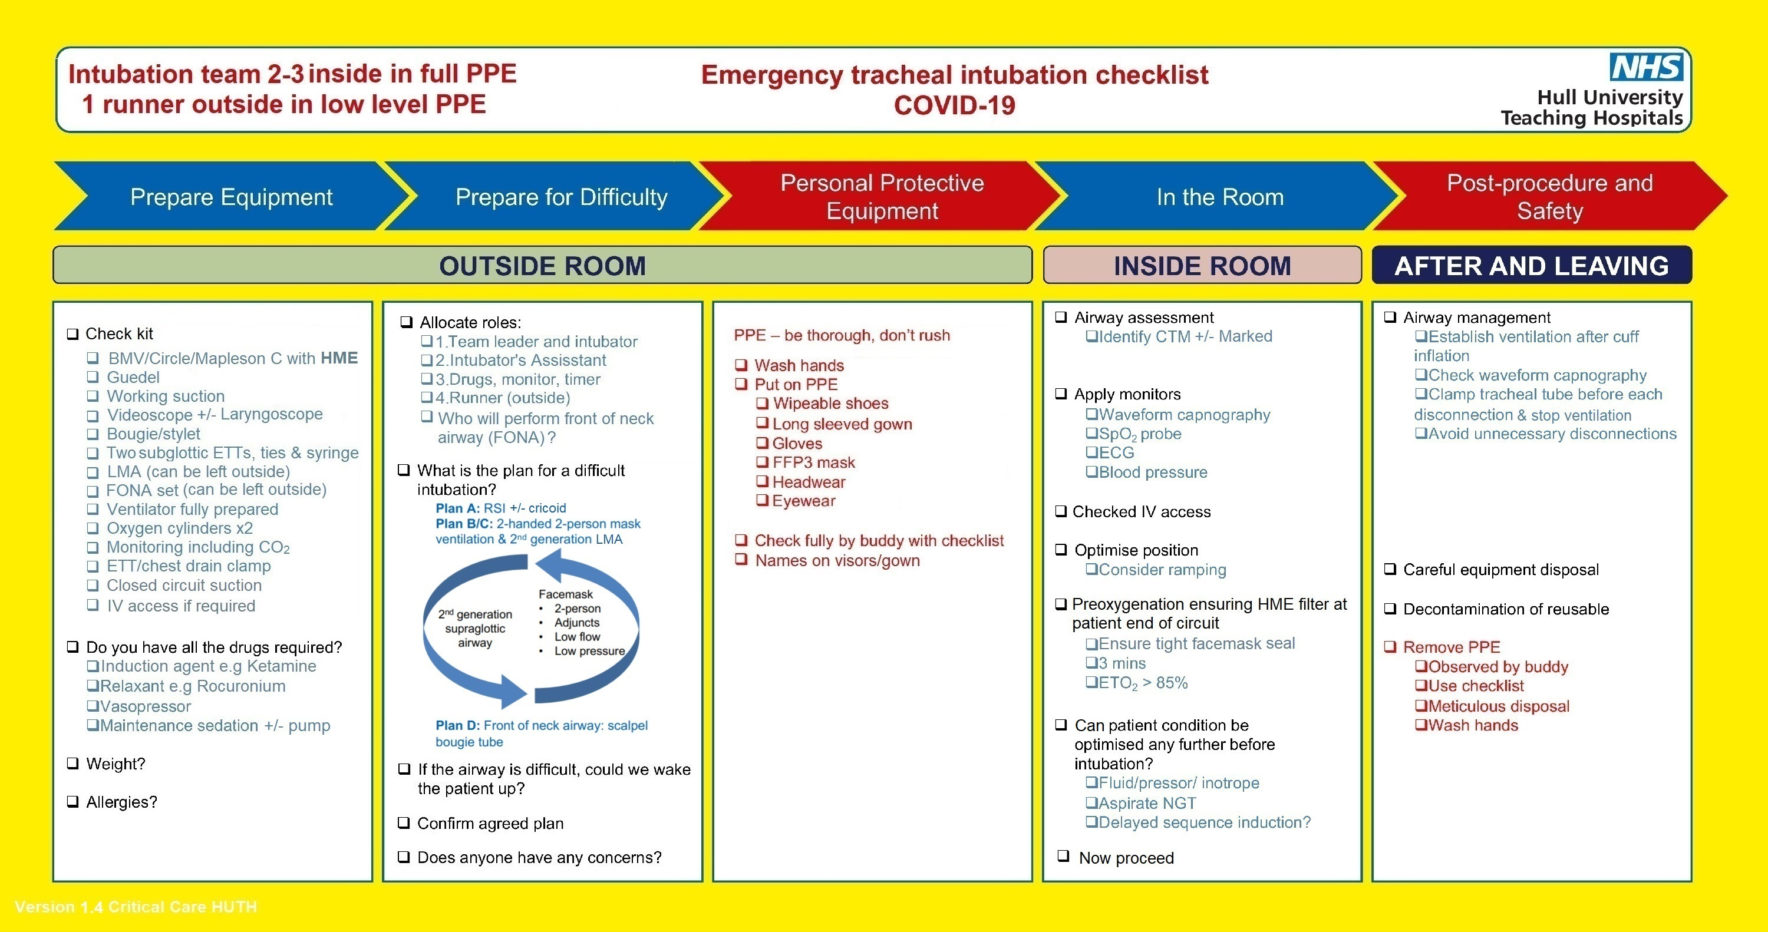
Creating a COVID-19 Perioperative Pathway using Simulation: A Quality Improvement Project
Zoe Wellbelove & Paul Sellens, Dave Wright, Grzegorz Grezlinski, Tom Kelly, Charlotte Devereaux-Walsh
Department of Anaesthesia, Hull University Teaching Hospital NHS Trust
Introduction
The COVID-19 pandemic presented an immediate threat to the global population and healthcare organisations. Initially, little was known about the effect of COVID-19 on patient’s requiring surgery. Patient outcomes and transmission between patient’s and healthcare workers were the biggest concerns. ^{1,2,3} In line with guidance at the time from the Joint Royal Colleges, and Public Health England, new procedures were needed within working hospital systems to manage the perioperative care of patients with COVID-19 infection. ^{2,3}
Simulation creates a model of reality in a safe and controlled environment which maximises learning whilst minimising the risk of exposure to COVID-19. We used in situ simulation to map the patient’s journey through our hospitals. This informed new protocols and procedures to optimise infection control in theatres in the two acute hospitals at the Hull University Teaching Hospitals NHS Trust
Figure 2: Intubation Checklist
Figure 3: Action cards for COVID Theatres
Conclusion and Discussion
Results
Figure 1: PDSA cycle
Allowing surgical activity to continue during the COVID-19 pandemic in a safe and effective manner was challenging for hospital trusts in what was an uncertain time.^{4,5,6}
We successfully used a quality improvement model with in-situ simulation to provide an authentic, safe and accessible learning environment for all members of the theatre team. This resulted in a prompt, effective and collaborative approach to the creation of perioperative protocols in COVID-19 patient’s. Using simulation for testing and training new infection control measures improved the safety and well-being of theatre staff and optimised patient care during the pandemic.
Using the quality improvement model and involving all members of the theatre team has allowed the process of evaluation and modification to continue throughout the pandemic. Theatre protocols have continuously been updated in response to changes in local and national guidance.
The process encouraged team working and staff engagement, and helped improve staff confidence and morale at a very challenging time.
Aims
To create perioperative protocols for patients with suspected COVID-19 infection requiring surgery
To provide in-situ simulations for theatre teams to improve understanding and confidence in perioperative approach to COVID-19 patients
Nine theatre in-situ simulation sessions were conducted with over 100 participants from theatre teams across the Hull University Teaching Hospitals Trust. MDT members from the following surgical teams attended the simulations; general surgery, vascular surgery, orthopaedic surgery, plastic surgery, maxillofacial surgery, paediatric surgery and neurosurgery.
All participants stated a significant improvement in confidence in the perioperative approach to COVID-19 patients and found simulation a useful training experience.
Speciality and theatre location specific COVID-19 perioperative pathways were created using the model described. Protocols for patient flow, donning and doffing of PPE, intubation (Figure 2) and management of intraoperative events were defined. Methods for exchanging equipment and samples were tested, including use of an ‘air lock’ system. Communication in full PPE was reported as the biggest challenge, but improved with use of an inside runner and outside circulator and communication aids such as whiteboards and a portable intercom system.
Action cards (Figure 3) were created for each surgical specialty or theatre location with subsections to describe the role of each individual staff group within the theatre team. These were placed in all theatres for easy access when required.
Methods
Using the Plan, Do, Study, Act model (Figure 1), scenarios were written to represent the patient's surgical journey, including pre-operative preparation, anaesthesia and intubation, intra operative procedure and post-operative care.
We simulated multiple scenarios over a 2 week period. Staff from all disciplines within the theatre work force were included to maximise learning for the team as a whole. The scenario was introduced and the current working protocol explained. The case was then simulated with the team and intraoperative events tested against the current protocol e.g. requirement for new equipment in theatre. A modified intubation technique for use in COVID-19 was simulated and refined according to local practice and equipment. Speciality specific events were also tested e.g. x-ray equipment in theatre. Debriefs were conducted, key learning points reviewed and qualitative feedback collected. This allowed us to modify the protocol before the next simulation where changes could again be tested and evaluated.
References
Lupia T, Scabini S, Mornese Pinna S, et al. 2019 novel coronavirus (2019-nCoV) outbreak: a new challenge. J Glob Antimicrob Resist. 2020
Public Health England. Guidance: Reducing the risk of transmission of COVID-19 in the hospital setting. https://www.gov.uk/government/publications/wuhan-novel-coronavirus_x005F_x0002_infection-prevention-and-control/reducing-the-risk-of-transmission_x005F_x0002_of-covid-19-in-the-hospital-setting (accessed 12/06/2020).
ICM Anaesthesia COVID-19 group. COVID-19 airway management principles. https://icmanaesthesiacovid-19.org/covid-19-airway-management-principles (accessed 12/06/2020).
Zheng H, Hébert HL, Chatziperi A, et al. Perioperative management of patients with suspected or confirmed COVID-19: review and recommendations for perioperative management from a retrospective cohort study. Br J Anaesth. 2020
Bui, N., Coetzer, M., Schenning, K.J. et al. Preparing previously COVID-19-positive patients for elective surgery: a framework for preoperative evaluation. Perioper Med 10, 1 (2021).
El‐Boghdadly, K., Cook, T.M., Goodacre, T., Kua, J., Blake, L., Denmark, S., McNally, S., Mercer, N., Moonesinghe, S.R. and Summerton, D.J. (2021), SARS‐CoV‐2 infection, COVID‐19 and timing of elective surgery. Anaesthesia.
Notes:
Download more poster presentation templates from FPPT.com

